Slide 1


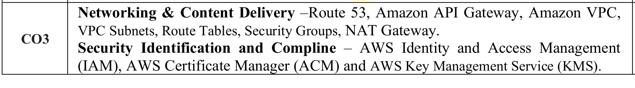

AWS Cloud Practitioner

Slide 2
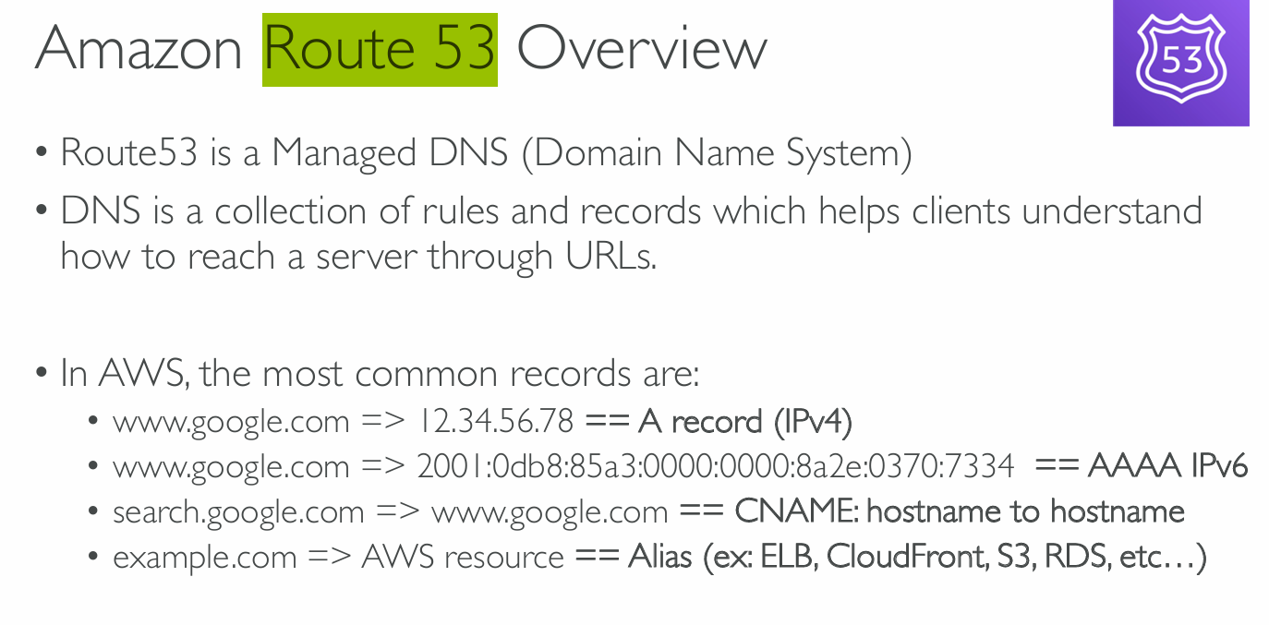


Slide 3
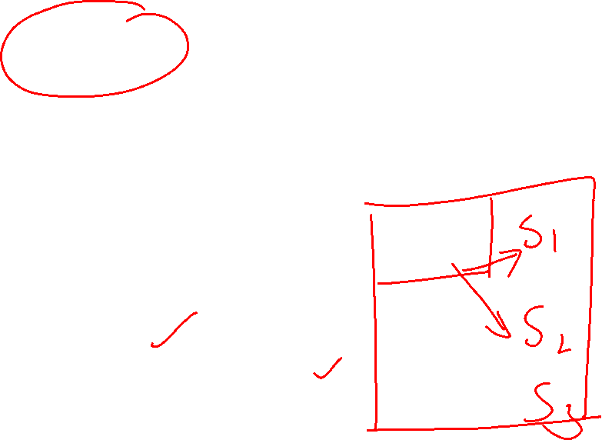
AWS Route 53
Amazon Route 53 is used to register new domains, transfer existing domains, route traffic for your domain to your AWS and external resources, and monitor the health of your resources.
AWS Route 53 functions:-
DNS management Traffic management
Availability monitoring (health check) Registration of domain

Slide 4

Example
You type www.google.com in your browser (like knowing your friend's name).
But your computer doesn’t know where that is — it needs an IP address (like an actual home address).
So, it asks Route 53 (the phone book): “Where is www.google.com?”
Route 53 says: “Here’s the IP address: 12.34.56.78”
Now your computer can go to that address and open Google.
What about different record types?
A Record = “John lives at 12 Main Street” (IPv4 address)
AAAA Record = “John lives at a newer address with a longer format” (IPv6)
CNAME Record = “Search for John at his office” → redirects to “John’s home” (one name pointing to another name)
Alias Record = Like a shortcut to known places in your AWS town — ELB, S3, etc.

Slide 5
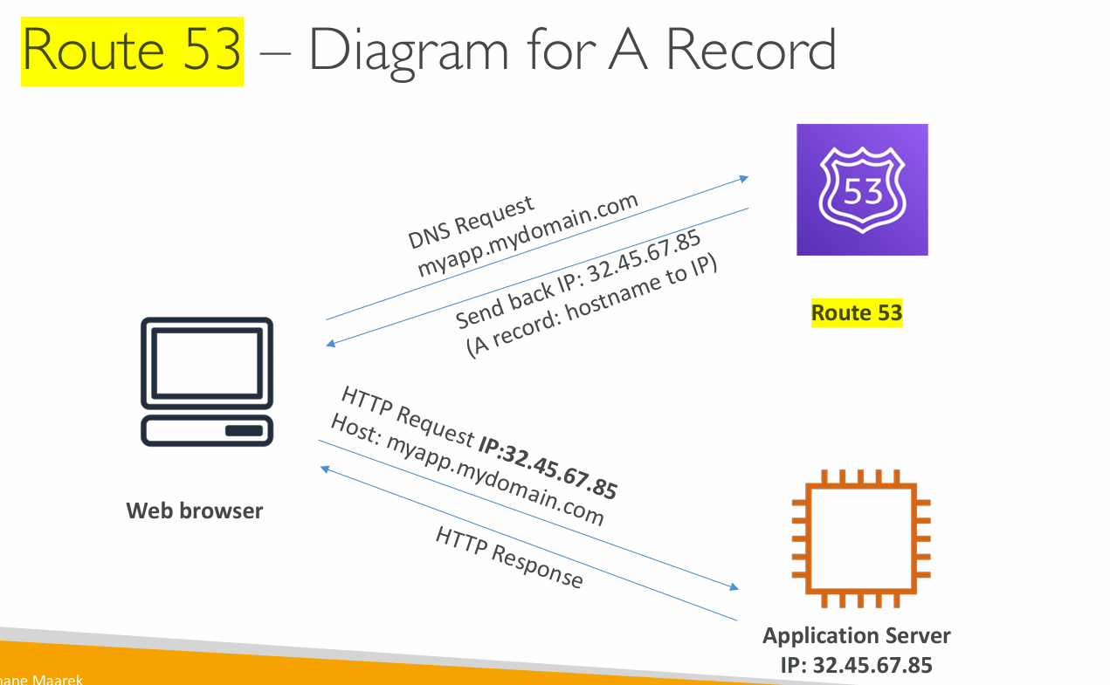

Slide 6
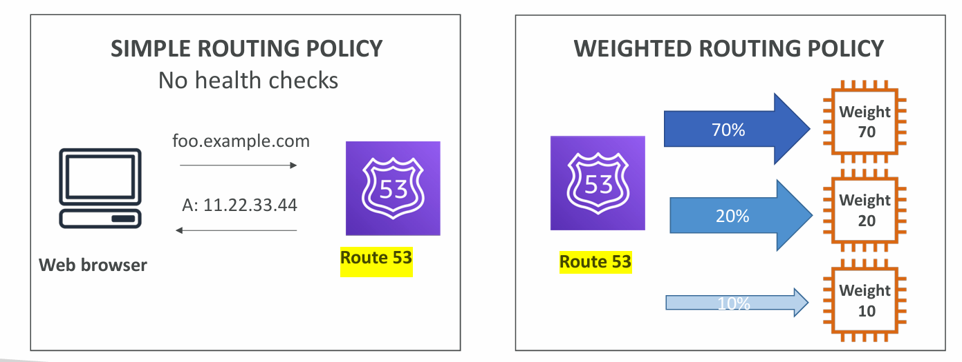
Route 53 Routing Policies

Slide 7
1. Simple Routing Policy (Left Side)
It maps one domain name (like foo.example.com) to one IP address (like 11.22.33.44).
No load balancing, no failover, no health checks.
Example:
If someone visits foo.example.com, Route 53 always responds with the same IP.
Real world scenario:
Think of it like giving only one restaurant's address to everyone who asks, regardless of traffic or whether it’s open or closed.

Slide 8
Understand
1. ❌ No Load Balancing :It does not distribute traffic across multiple servers. As a result All users are sent to one specific IP address or server, even if it's slow or overloaded. Example: If 10,000 people visit your site, they are all sent to the same server — which may crash.
2. ❌ No Failover: It doesn’t automatically switch to a backup server if the main one goes down. As a result if your server is unavailable or crashes, the users will see errors or your site will be down. Example: If Server A is offline, Route 53 will still try to send users to it — because it doesn’t know it’s down.
3. ❌ No Health Checks: Route 53 does not monitor the server to check if it's working properly. As a result Even if the server is not responding (unhealthy), Route 53 will continue to route traffic to it. Example: Unlike advanced routing, Simple Routing doesn’t check if the destination is online or offline.

Slide 9

2. Weighted Routing Policy
Allows you to distribute traffic across multiple servers/resources.
You assign a weight (in %) to each server, controlling how much traffic goes to each one. Such as 70% of the requests go to the first server, 20% to the second, 10% to the third.
This is useful for:
Load testing new servers,
Gradually shifting traffic during migrations,
Running different versions of an app (A/B testing).
Real world scenario: You’re spreading out the crowd intentionally.
Imagine you run 3 food stalls and you tell people:
"Go to stall A 70% of the time, stall B 20%, and stall C 10%."

Slide 10
How to distribute traffic across multiple servers/resources?
When users visit www.example.com, Route 53 will:
Send 80% of traffic to EC2-1 (Mumbai)
Send 20% of traffic to EC2-2 (Ohio)
This is useful when:
You are testing a new version on one EC2 instance.
You want to gradually shift traffic to a new server.
You want to balance traffic based on capacity or cost.

Slide 11
How to Set It Up in Route 53:
Or practically
How to distribute traffic across multiple servers/resources?
Go to Route 53 → Hosted Zones → Your Domain
Click Create Record
Add:
Name: www.example.com
Record type: A – IPv4 address
Routing Policy: Weighted
IP address: 3.91.123.10
Weight: 80
Add another record:
Same Name: www.example.com
Type: A
IP address: 52.91.45.200
Weight: 20

Slide 12
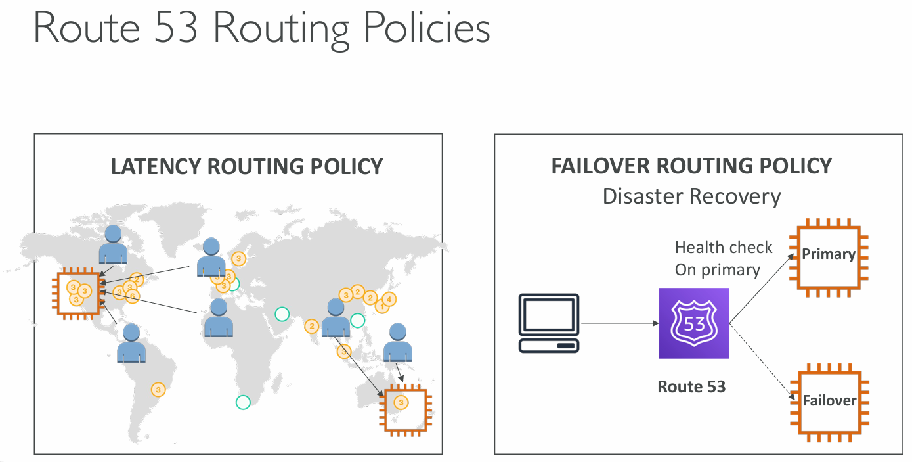

Slide 13
1. Latency Routing Policy
To route user requests to the AWS region that provides the lowest latency (fastest response time).
The world map shows users distributed across different regions.
Each user is directed to the nearest AWS region based on latency, not geography.
For example:
A user in Europe may be routed to a data center in Ireland if it has lower latency.
A user in Asia may be routed to Singapore or Tokyo based on performance.
This is useful for improving application performance for global users.

Slide 14

Latency Routing Policy – EXAMPLE
You run a global video streaming platform hosted on AWS with users in India, USA, and Japan.
🔸Setup:
You deploy your application in three AWS regions:
Mumbai (ap-south-1)
Oregon (us-west-2)
Tokyo (ap-northeast-1)
Route 53 uses latency routing to direct users to the region that gives the lowest network latency.
🔸How it works:
A user in Delhi will be routed to Mumbai region (ap-south-1).
A user in Osaka will be routed to Tokyo region (ap-northeast-1).
This improves performance because users are connected to the fastest responding server, not just the geographically nearest one.

Slide 15

1. Why Closest ≠ Fastest:
Even if two regions are geographically close, latency depends on:
Internet congestion
ISP routing paths
Network health
Server load
2. AWS Continuously Monitors Global Network Performance
AWS has a vast global monitoring system.
It collects latency data between AWS regions and users all over the world using:
Internal measurement tools
Route 53 latency records
Health checks
DNS queries
These tests measure actual network travel time (ping, round-trip time).

Slide 16
3. Route 53 Stores and Uses Latency Maps for the checkups
Based on the above monitoring, AWS builds a latency map.
For every geographic location (like a country or region), AWS knows:
"Users in this area reach Ireland in 45 ms, Paris in 60 ms today."
When a DNS query comes in, Route 53 checks this map and chooses the fastest region.

Slide 17

Failover Routing Policy
Failover Routing Policy is used when you want high availability — that means if your primary server goes down, traffic is automatically redirected to a secondary (backup) server.
How it Works:
You configure two records in Route 53:
Primary record — points to the main server.
Secondary (failover) record — points to a backup server.
You enable health checks on the primary record.
If Route 53 sees that the primary server is unhealthy, it sends traffic to the secondary.

Slide 18


2. Failover Routing Policy – Real AWS Scenario
You host a critical banking web application.
🔸Setup:
You deploy the primary website in N. Virginia (us-east-1).
You deploy the failover backup site in Ohio (us-east-2).
You set up Route 53 health checks to monitor the primary application.
🔸How it works:
When the N. Virginia server is healthy, all traffic is routed there.
If that region goes down (e.g., outage, application failure), the health check fails.
Route 53 automatically redirects users to the Ohio region where the standby application is ready.
This ensures high availability and disaster recovery — your users won’t even notice the primary has failed.

Slide 19
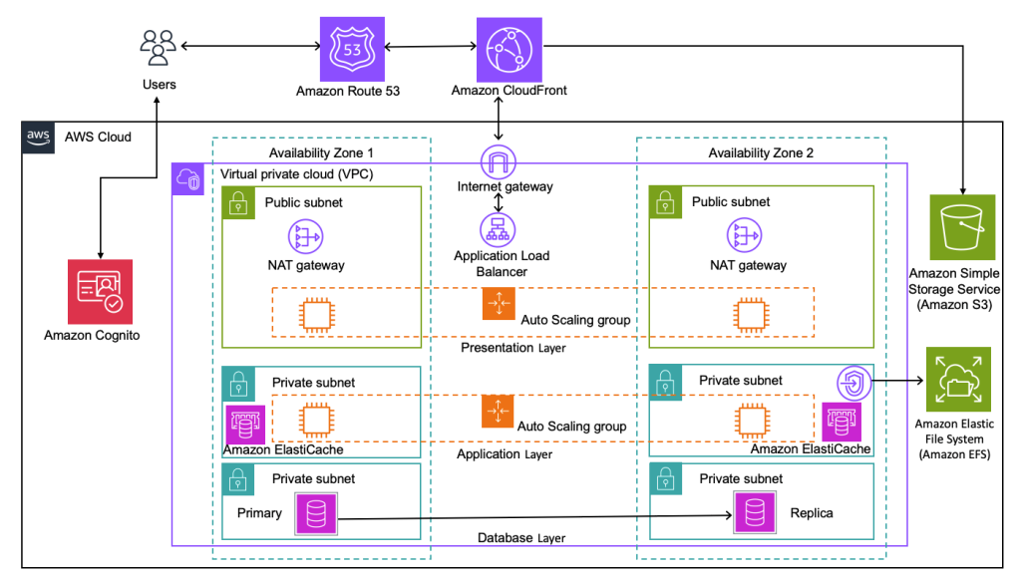

Route 53

Slide 20
Components of Route 53
From | To | Purpose
Users | Route 53 | DNS resolution
Route 53 | CloudFront | Content delivery
CloudFront | ALB | Traffic routing
ALB | EC2 Auto Scaling (frontend) | Load balancing
Frontend | Backend | Business logic
App Layer | Cognito | Authentication
App Layer | ElastiCache | Caching
App Layer | DB | Data access
DB | Replica | High availability
App Layer | S3, EFS | Static file & file system access

Slide 21
Amazon Cognito- It is AWS’s secure service for user authentication, authorization, and identity management — used in real apps to manage login, access control, and integration with AWS services.
1. Users → Amazon Route 53
Route 53 is the DNS service.
Users type a domain name (e.g., www.myapp.com) and Route 53 resolves it to the correct AWS resource.
2. Amazon Route 53 → Amazon CloudFront
CloudFront is a Content Delivery Network (CDN).
It caches and delivers static/dynamic content globally with low latency.
Route 53 directs the request to CloudFront for faster access.

Slide 22
3. CloudFront → Application Load Balancer (via Internet Gateway)
CloudFront forwards the request to the Application Load Balancer (ALB).
The Internet Gateway (IGW) allows the load balancer to accept public traffic.
ALB distributes incoming traffic to EC2 instances in multiple AZs.
4. Application Load Balancer → Auto Scaling Group (Presentation Layer)
ALB routes the traffic to EC2 instances running in Auto Scaling Groups.
The Presentation Layer handles the frontend logic (e.g., UI).

Slide 23
5. Presentation Layer → Auto Scaling Group (Application Layer)
The frontend passes requests to the Application Layer.
This handles business logic, APIs, and backend processing.
6. Application Layer ↔ Amazon Cognito
Cognito handles authentication and authorization.
Users are authenticated before accessing secure parts of the app.
This happens outside the VPC — Cognito is a managed service.
7. Application Layer ↔ Amazon ElastiCache
ElastiCache is used to cache frequent queries to reduce database load.
Speeds up the app by storing session data, user preferences, etc.

Slide 24
8. Application Layer ↔ Primary Database (Private Subnet)
The application makes reads/writes to the Primary DB instance.
Located in a private subnet for security.
9. Primary → Replica Database
A read replica ensures high availability and read scalability.
Replication ensures the data is available across AZs.
10. Application Layer ↔ Amazon S3 & Amazon EFS
S3 stores static files like images, documents, and backups.
EFS provides shared, scalable storage for EC2 instances (like file systems).
Both are accessed via private routes and security permissions.

Slide 25
Breakdown of Components by Layer
🔹 Network Layer
VPC (Virtual Private Cloud): Isolated cloud network.
Availability Zones: Two AZs ensure high availability.
Internet Gateway: Connects VPC to the internet.
NAT Gateway: Allows private subnets to access the internet (e.g., for updates), but not be accessed from it.
🔹 Presentation Layer
Handles UI/frontend.
EC2 instances run inside Auto Scaling Groups for elasticity.
🔹 Application Layer
Hosts business logic and APIs.
Uses ElastiCache for performance, and talks to the database layer.
🔹 Database Layer
Primary DB: Handles read/write.
Replica DB: Handles read-only traffic for load distribution.

Slide 26
🔹 Storage
Amazon S3: Object storage (images, backups).
Amazon EFS: Scalable file system for EC2.
🔹 Authentication
Amazon Cognito: Authenticates users securely (social logins, email, etc.)
🔹 Routing & Caching
Amazon Route 53: Domain name system (DNS).
Amazon CloudFront: CDN for fast global delivery.
🔹 Auto Scaling
Automatically adds/removes EC2 instances based on load.

Slide 27
AWS Route 53
Route 53 performs three main functions
Register a domain
As a DNS, it routes internet traffic to the resources for your domain
Check the health of your resources
Route 53 sends the automated requests over the internet to a resource (can be a webserver) to verify that server is reachable, functional and available.
Also you can choose to receive notification when a resource becomes unavailable and choose to route internet traffic away from unhealthy resources.

Slide 28
AWS Route 53
When you register a domain with route 53,the service automatically makes itself the DNS service for the domain by doing the following-
It creates a hosted zone that has the same name as your domain
It assigns a set of four name servers to the hosted zone, unique to the account.
When someone uses a browser to access your website, the name server inform the browser where to find your resources, such as a web server or an amazon S3 bucket.
It gets the name server from the hosted zone and add them to the
domain
ns-123.awsdns-45.org
ns-456.awsdns-12.com
ns-789.awsdns-99.net
ns-321.awsdns-77.co.uk

Slide 29


AWS Route 53
AWS supports
Generic Top level domains (.com,.org…
Geographic Top level domain(.in,.uk…
Registering a domain with Route 53
You can register a domain with route 53. if the TLD is included on the supported TLD list
If the TLD is not included, you can’t register the domain with route 53

Slide 30
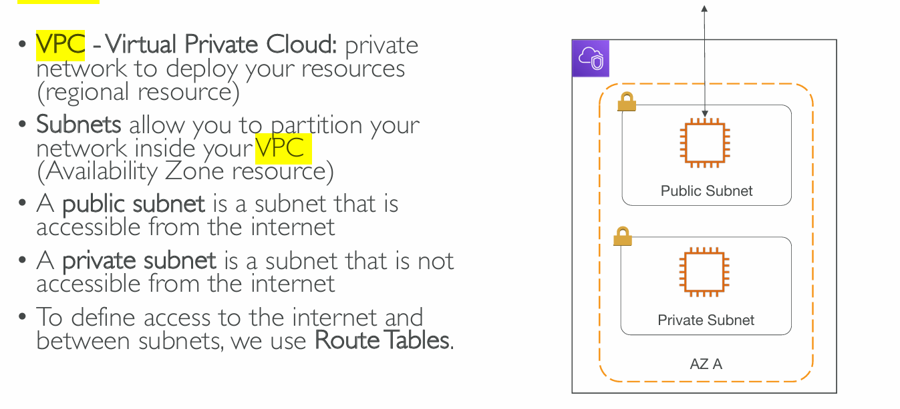
VPC and subnets
www

Slide 31
VPC architecture

Slide 32
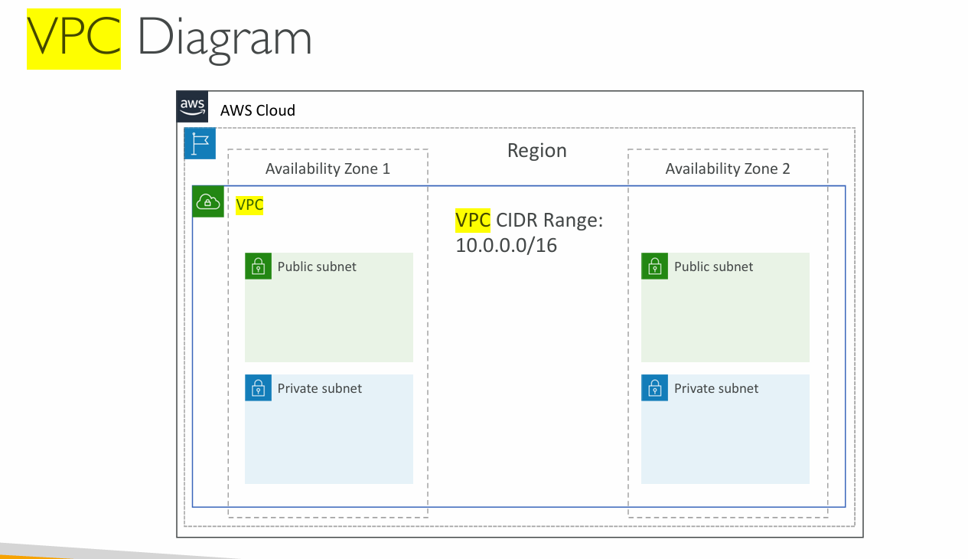

Slide 33
Types of VPC
Default VPC
Created in each AWS region when an AWS account is created
Has default CIDR, security group, NACL and routing table settings.
Has an Internet gateway by default
Custom VPC
It is a VPC on AWS account owner creates
AWS user creating custom VPC can decide the CIDR
Has its own default security group, network ACL, and routing tables
Does not have an Internet gateway by default, one needs to be created if needed

Slide 34
Virtual Private Cloud (VPC)
A VPC (Virtual Private Cloud) is a logically isolated private network in a cloud environment, allowing you to launch and manage cloud resources securely. It functions like a virtual data center within a cloud provider such as AWS, Azure, or Google Cloud.
Key Features of a VPC
Isolation & Security
Resources inside a VPC are isolated from other VPCs and the public internet
(unless explicitly configured).
Security is enforced using Security Groups and Network ACLs.
Custom IP Addressing
You define a CIDR block (e.g., 10.0.0.0/16) to allocate private IPs to your resources.
The CIDR block determines how many subnets can be created inside the VPC.
9

Slide 35
Virtual Private Cloud (VPC)
Subnets
A VPC is divided into subnets, which can be either public (accessible from the internet) or private (isolated from the internet).
Subnets help in organizing and distributing resources across Availability Zones (AZs).
Routing & Connectivity
Route tables control network traffic inside and outside the VPC.
Internet Gateway (IGW) enables public internet access.
NAT Gateway/NAT Instance allows private subnets to access the internet securely.
VPC Peering & Transit Gateway allow inter-VPC communication.

Slide 36
Virtual Private Cloud (VPC)
Scalability & Flexibility
Multiple subnets can be created inside a VPC.
You can connect on-premises networks using VPN or Direct Connect.
Supports integration with Load Balancers, Firewalls, and Private Endpoints

Slide 37
Steps to create VPC in aws
Seach for VPC in aws console
Write the steps to create each of the following
Create a VPC
Create a subnet
Crate internet gateway
Create routing table

Slide 38
Subnet
Public subnet (IGW is connected)
If a subnet’s traffic is routed to an IGW, the subnet is known as a public
subnet.
If you want your instance in a public subnet to communicate with the internet over IPV4, it must have a public IPV4 address (dynamic) or on Elastic IP address (doesn’t changed).
Private subnet (not connected with IGW)
If a subnet does not have a route to the internet gateway, the subnet is known as a private subnet.
When you create a VPC, you must specify on IPV4 CIDR block for the
VPC.The allowed block size is between /16 to /28 netmask.
The first four and last IP address of subnet can not be changed.

Slide 39
Subnet
Suppose CIDR=10.0.0.0/16
10.0.0.0- network address
10.0.0.1-reserved by AWS for the VPC router
10.0.0.2- reserved by AWS.The IP address of DNS server 10.0.0.3-reserved for future use
10.0.0.255-Broadcast address
Other are available for your EC2’s except the five

Slide 40
1. Subnet: 10.0.0.0/24
This means:
CIDR block: 10.0.0.0/24
Total IPs: 256 addresses
Usable IPs: 254 (AWS reserves 5)
🔹 Range of IPs:
From: 10.0.0.0 (network address)
To: 10.0.0.255 (broadcast address)
🔹 Usable IP addresses:
From 10.0.0.1 to 10.0.0.254
AWS reserves 5 IPs in each subnet:
10.0.0.0 – Network address
10.0.0.1 – Reserved by AWS for VPC router
10.0.0.2 – Reserved by AWS
10.0.0.3 – Reserved by AWS
10.0.0.255 – Broadcast address (not usable)
2. Subnet: 10.0.1.0/24
This means:
CIDR block: 10.0.1.0/24
Total IPs: 256 addresses
Usable IPs: 254
🔹 Range of IPs:
From: 10.0.1.0
To: 10.0.1.255
🔹 Usable IP addresses:
From 10.0.1.1 to 10.0.1.254
AWS reserves 5 addresses here as well:
10.0.1.0 – Network address
10.0.1.1 – Reserved by AWS for VPC router
10.0.1.2 – Reserved by AWS
10.0.1.3 – Reserved by AWS
10.0.1.255 – Broadcast address

Slide 41
Security Groups
In AWS (Amazon Web Services), a Security Group (SG) in a VPC (Virtual Private Cloud) acts as a virtual firewall that controls inbound and outbound traffic for AWS resources like EC2 instances, RDS databases, and Lambda functions (when using VPC networking).
Key Features of AWS Security Groups:
Stateful:
If an inbound rule allows traffic, the outbound response is automatically
allowed.
If an outbound rule allows traffic, the inbound response is automatically allowed.
Inbound and Outbound Rules:
You can define allow rules for both directions.
Deny rules are not supported (use Network ACLs for explicit
denies).
28

Slide 42
Security Groups
Attached to Resources:
Each resource (e.g., EC2 instance) can have multiple Security Groups.
One Security Group can be assigned to multiple resources.
Default Behavior:
By default, all inbound traffic is denied.
All outbound traffic is allowed unless restricted.

Slide 43
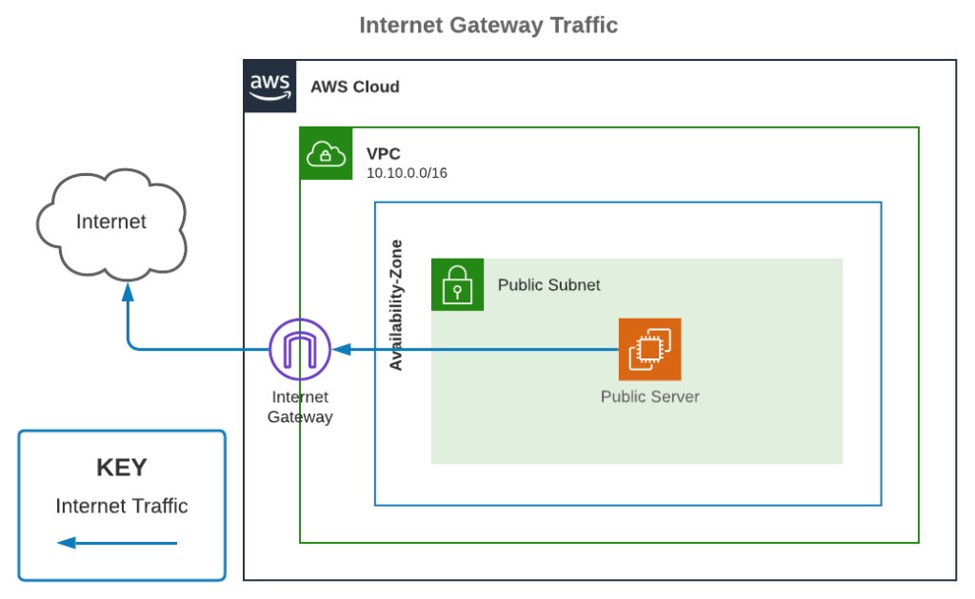
Internet gateway

Slide 44
Internet gateways
Internet Gateway (IGW) is a horizontally scaled, redundant, and highly available VPC component that allows communication between your VPC and the internet.
Internet Gateway enables resources (like EC2 instances) in public subnets to connect to the internet. Similarly, resources on the internet can initiate a connection to resources in your subnet using the public IP.
If a VPC does not have an Internet Gateway, then the resources in the VPC cannot be accessed from the Internet (unless the traffic flows via a Corporate Network and VPN/Direct Connect).
Internet Gateway supports IPv4 and IPv6 traffic.
Internet Gateway does not cause availability risks or bandwidth constraints on your network traffic.
In order to make subnet public, add a route to your subnet’s route table that directs internet-bound traffic to the internet gateway.
You can associate exactly one Internet Gateway with a VPC.
Internet Gateway is not Availability Zone specific.
There’s no additional charge for having an internet gateway in your account.

Slide 45
Internet Gateway
IGW is a virtual router that connects a VPC to the Internet
Default VPC is already attached with an IGW
If you create a new VPC then you must attach the IGW in order to access the Internet
Ensure that your subnet’s route table points to the IGW
It performs NAT between your private and public IPV4 address.
It supports both IPV4 and IPV6

Slide 46
Route Tables,
A route table contains a set of rules, called routes, that determine where network traffic from a subnet or gateway is directed. Each route specifies a destination and a target. The destination is the range of IP addresses to which you want traffic to go, and the target is the gateway, network interface, or connection through which that traffic should travel.

Slide 47
How Route Tables Work
A route table is essential for controlling the flow of traffic within a virtual private cloud (VPC) and between the VPC and external networks. Here’s a breakdown of its key components and functions:
Destination: This is a CIDR block (e.g., 10.0.0.0/16) that specifies the range of IP addresses for which a route applies. For example, a destination of 0.0.0.0/0 represents all IP addresses outside the VPC, which is often used for internet traffic.
Target: This is the next hop for the traffic. The target could be:
An Internet Gateway (IGW) for outbound internet access.
A NAT Gateway for private subnet instances to access the internet.
A Virtual Private Gateway (VGW) for connecting to a corporate network via a VPN.
A Peering Connection to route traffic to another VPC.
An Elastic Network Interface (ENI) to send traffic to a specific instance or a VPC endpoint.

Slide 48
Types of Route Tables
Main Route Table: Every VPC comes with a default main route table. By default, all subnets are implicitly associated with the main route table unless you explicitly associate them with a custom route table. You can modify the main route table, but you cannot delete it.
Custom Route Table: You can create custom route tables and explicitly associate them with specific subnets. This allows for more granular control over network traffic. For example, you can have one custom route table for public subnets that directs traffic to an Internet Gateway and another for private subnets that directs traffic to a NAT gateway.
Example
Let's consider a common scenario with a public and a private subnet.
Public Subnet: The route table for the public subnet has a route for all internet traffic (0.0.0.0/0) that points to an Internet Gateway. This allows instances in this subnet to have direct internet access.
Private Subnet: The route table for the private subnet has a route for all internet traffic (0.0.0.0/0) that points to a NAT Gateway. This allows instances in this subnet to access the internet for updates or patches, but prevents unsolicited inbound connections from the internet.

Slide 49
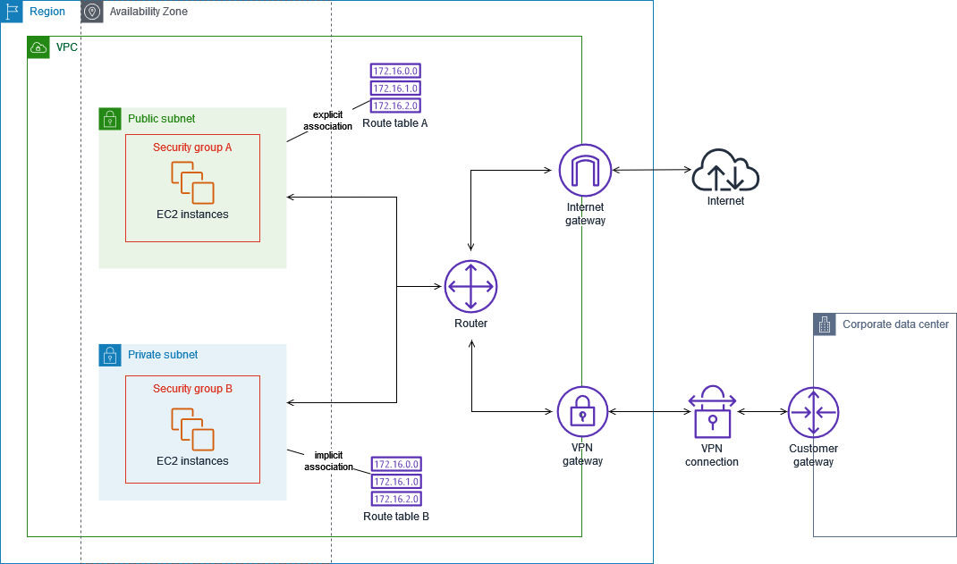
Arcchitecture

Slide 50
NAT gateways
A NAT gateway (Network Address Translation gateway) is a managed service that allows resources in a private subnet to securely access the internet or other external services. It does this by translating the private IP addresses of the instances into a single, public IP address. This enables outbound-only communication, meaning instances can initiate connections to the outside world, but outside services can't initiate connections back to them.

Slide 51
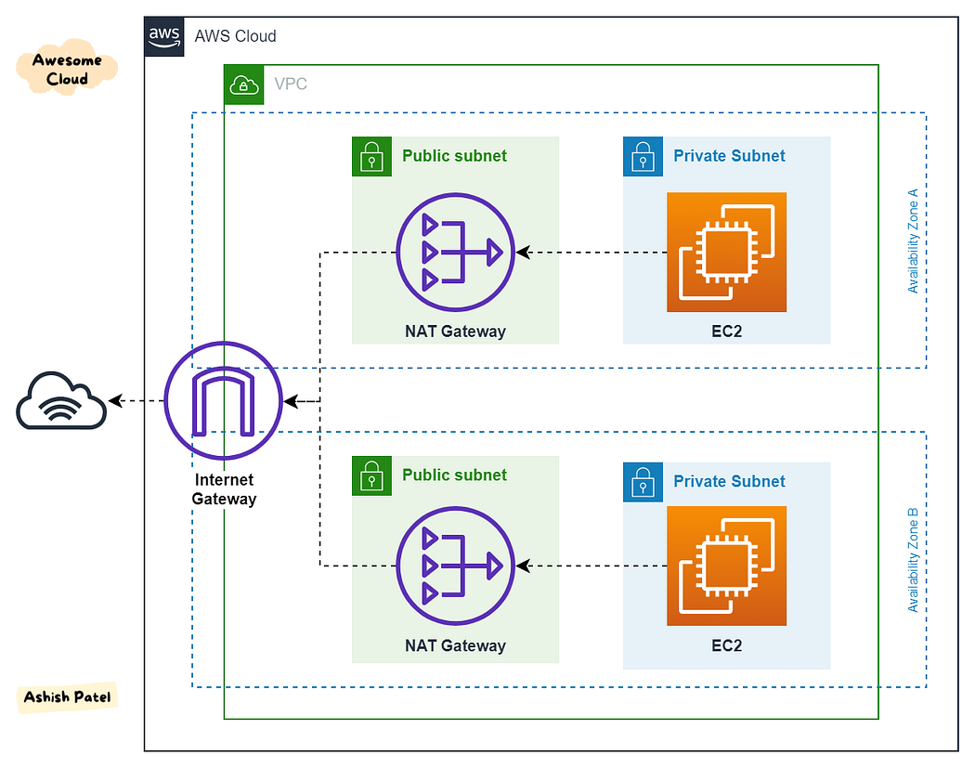
VPC and NAT gateways architecture

Slide 52
Other General Information
NAT Gateway (NGW) is a managed Network Address Translation (NAT) service.
NAT Gateway does something similar to Internet Gateway (IGW), but it only works one way: Instances in a private subnet can connect to services outside your VPC but external services cannot initiate a connection with those instances.
NAT gateways are supported for IPv4 or IPv6 traffic.
NAT gateway supports the following protocols: TCP, UDP, and ICMP.
Each NAT gateway is created in a specific Availability Zone and implemented with redundancy in that zone.
If you have resources in multiple Availability Zones and they share one NAT gateway, and if the NAT gateway’s Availability Zone is down, resources in the other Availability Zones lose internet access.
To create an Availability Zone-independent architecture, create a NAT gateway in each Availability Zone.
You can associate exactly one Elastic IP address with a public NAT gateway.
You are charged for each hour that your NAT gateway is available and each Gigabyte of data that it processes.

Slide 53
Key Features
Outbound-Only Communication: This is the primary function. Instances in a private subnet can connect to the internet to get software updates, patches, or access APIs, but the internet can't initiate a connection to those instances. This provides a crucial layer of security.
High Availability & Scalability: They are designed for high availability within an AZ and automatically scale to handle varying traffic demands.
Simplified Management: You don't need to manually configure and manage NAT instances, which reduces administrative overhead.
Cost-Effectiveness: Instead of assigning a public IP address to every single instance in a private subnet, you can use a single NAT gateway with one public IP address to serve multiple instances.
Support for Multiple Protocols: NAT gateways typically support common protocols like TCP and UDP, and some also support ICMP.

Slide 54
NAT gateways (other general information)
NAT gateway is always made in public subnet and used for private subnet.
Router is made insideVPC or region
Once the VPC is created, you can not change its CIDR block range. The different subnets within a VPC cannot overlap.
You can expand your VPC CIDR by adding new/extra IP address ranges

Slide 55
NAT Gateway
You can use a Network Address Translation (NAT) gateway to enable instances in a private subnet to connect to the internet or other AWS services, but prevent the internet from initiating a connection with those instances.
You are charged for creating and using a NAT gateway in your account.
NAT gateway uses elastic IP and not public IP.
Generally, web servers are stored in a public subnet so user can access my web site.
Database servers are stored in private subnet, so no one can access my database.
To create a subnet gateway, you must specify the public subnet in which the NAT
2g5ateway should reside.

Slide 56
NAT Gateway
You must also specify an Elastic IP address to associate with NAT gateway when you create it
No need to assign public IP address to your private instance
After you created a NAT gateway, you must update the route table associated with one or more of your private subnets to pint Internet bound traffic to the NAT gateway. This enables instances in your private subnet to communicate with the Internet.
Deleting a NAT gateway, disassociates its Elastic IP address, but does not release the address from your account.

Slide 58
AWS Identity and Access Management (IAM)
AWS Identity and Access Management (IAM) is a service that helps securely control access to AWS resources. It allows you to create and manage users, groups, roles, and permissions to enforce least privilege access.
Key Components of IAM
1. IAM Users
A user represents an individual person or application that needs access to AWS.
Each user has credentials (username/password, access keys).
Users can be assigned permissions via policies.
IAM Groups
A group is a collection of IAM users.
Policies assigned to a group apply to all members.
Example groups: Developers, Admins, ReadOnlyUsers.

Slide 59
AWS Identity and Access Management (IAM)
IAM Roles
Roles grant temporary access to AWS resources.
Used for:
Cross-account access (e.g., an AWS service accessing another AWS
service).
EC2 instances to access S3, DynamoDB, etc.
AWS Lambda to interact with other services.
IAM Policies
JSON-based documents that define permissions.
Can be attached to users, groups, or roles.
Two types:
AWS Managed Policies – Predefined AdministratorAccess).
Customer Managed Policies – Created by users.
by AWS (e.g.,

Slide 60
AWS Identity and Access Management (IAM)
Example IAM Policy (Allow S3 Access):
{
"Version": "2012-10-17",
"Statement": [
{
"Effect": "Allow",
"Action": "s3:*",
"Resource": "*"
}
]
}
IAM Identity Center (AWS SSO)
Helps manage single sign-on (SSO) for multiple AWS accounts.
Integrates with Active Directory, Okta, Google Workspace, etc.

Slide 61
AWS Certificate Manager (ACM)
AWS Certificate Manager (ACM) is a service that helps you provision, manage, and deploy SSL/TLS certificates for securing AWS-based applications and websites.
Key Features of ACM
Free Public Certificates
ACM provides free SSL/TLS certificates for AWS services like Elastic Load Balancer (ELB), CloudFront, and API Gateway.
These certificates auto-renew, eliminating manual renewal tasks.
Private Certificate Authority (CA)
ACM can issue private certificates for internal applications and
services.
Used for securing private networks, IoT devices, and internal APIs.

Slide 62
AWS Certificate Manager (ACM)
Automatic Renewal and Deployment
ACM automatically renews certificates before expiration.
Certificates integrate directly with AWS services (ELB, CloudFront, API Gateway, etc.).
Managed Certificate Lifecycle
ACM handles certificate issuance, renewal, and revocation.
You don’t need to manually upload or rotate certificates.
Custom Certificate Upload
You can import third-party SSL/TLS certificates from providers like
GoDaddy, DigiCert, and Let’s Encrypt.
Uploaded certificates must be manually renewed.

Slide 63

AWS Key Management Service (KMS)
AWS Key Management Service (KMS) is a managed encryption service that allows you to create, manage, and control cryptographic keys used to encrypt and decrypt data across AWS services and applications.
Key Features of AWS KMS
Centralized Key Management
Manage all your encryption keys securely in one place.
Integration with AWS Services
Seamlessly integrates with services
DynamoDB, CloudTrail, and more.
like S3, EBS, RDS, Lambda,

Slide 64
AWS Key Management Service (KMS)
Automatic Key Rotation
AWS automatically rotates keys to improve security (optional for customer-managed keys).
Logging and Auditing
AWS CloudTrail logs all key usage, helping with compliance and auditing.
FIPS 140-2 Compliance
KMS is FIPS 140-2 validated, making it compliant for government and enterprise security standards.

Slide 65
API Gateway
AWS API Gateway is a fully managed service that acts as a "front door" for applications to access data, business logic, or functionality from backend services. It allows developers to create, publish, maintain, monitor, and secure APIs at any scale. Think of it as a central hub for all incoming API requests, routing them to the correct backend service and handling a variety of tasks along the way.
When a client sends a request to your API, the AWS API Gateway intercepts it. It then handles a range of functions before forwarding the request to the appropriate backend service. These backend services can be anything from AWS Lambda functions and Amazon EC2 instances to other publicly accessible web services. After the backend service processes the request, the API Gateway receives the response and sends it back to the client.

Slide 66
Key Features and Benefits
API Management and Efficiency
API Types: You can create different types of APIs, including RESTful APIs (for stateless communication) and WebSocket APIs (for real-time, two-way communication).
Version Control: API Gateway lets you run multiple versions of the same API simultaneously. This is great for safely rolling out new features while older applications continue to use the previous version.
Traffic Management: It helps you manage traffic by setting throttling rules to prevent abuse and ensure your backend services can handle the load.

Slide 67
Security
Authentication and Authorization: API Gateway provides flexible security controls. You can use AWS Identity and Access Management (IAM), Amazon Cognito user pools, or custom Lambda authorizers to control who can access your APIs.
Protection: It can integrate with AWS WAF (Web Application Firewall) to protect your APIs from common web exploit

Slide 68
Performance and Scalability
Automatic Scaling: As a managed service, API Gateway automatically scales to handle any amount of traffic, so you don't have to worry about provisioning infrastructure for traffic spikes.
Caching: You can enable caching to store responses from your backend, which reduces latency and the number of requests made to your services.
Low Latency: It uses Amazon CloudFront's global network of edge locations to deliver the lowest possible latency for your API requests and responses.
Monitoring
Integrated with CloudWatch: API Gateway is integrated with Amazon CloudWatch, which gives you a dashboard to monitor performance metrics like API calls, latency, and error rates.

Slide 69
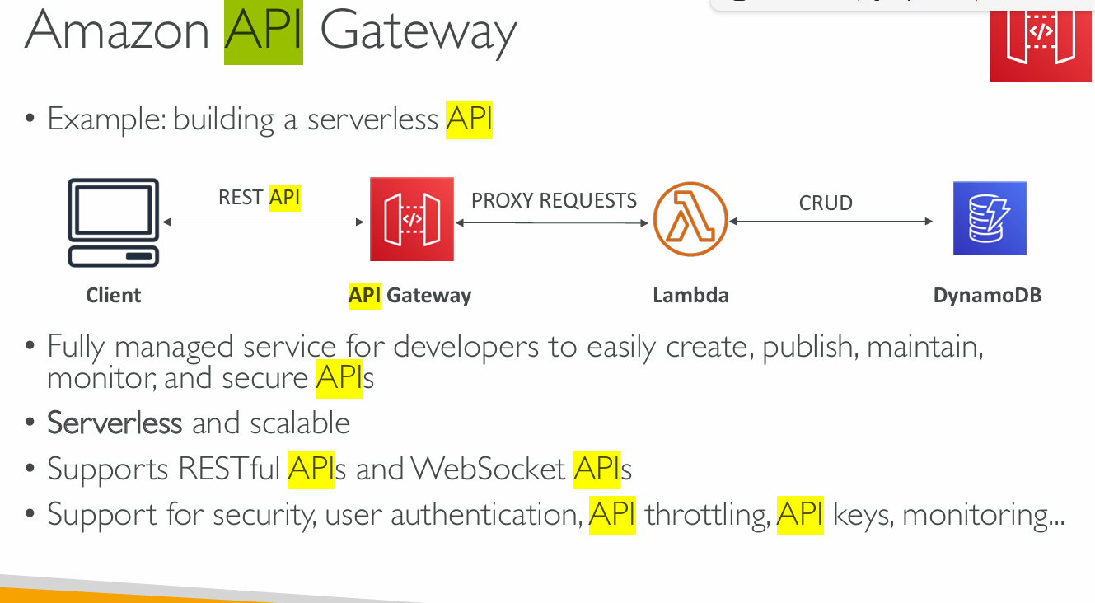

Slide 70
AWS API gateway
What is an API Gateway?
An API Gateway is like a front door or traffic controller for all the requests coming into your application.
It receives client requests (like from a browser or mobile app)
Routes them to the correct backend service (like AWS Lambda, EC2, or any HTTP endpoint)
Handles things like security, rate limiting, logging, and transformation

Slide 71
How API Gateway Works: Step-by-Step
Step 1: Client Sends Request
A mobile app or browser makes a request to your API.
Example: GET https://myapi.example.com/users
Step 2: API Gateway Receives the Request
It’s the first component to receive and process the HTTP request.
It checks if the request is valid, authenticated, and authorized.
⚙️ Step 3: Routing to Backend
Based on the path (like /users), the API Gateway routes the request to:
AWS Lambda function
EC2 instance
HTTP/HTTPS backend
AWS service like DynamoDB, etc.
Step 4: Backend Processes and Sends Response
The backend does its job (e.g., fetch data from a database).
It returns a response (e.g., a list of users) to the API Gateway.
Step 5: API Gateway Sends Response to Client
The API Gateway can modify (transform) the response if needed.
Finally, it returns the result to the client.

